Slide 1
Automated Testing vs Manual Testing
By Bhavin Turakhia
CEO, Directi
(shared under Creative Commons Attribution Share-alike License incorporated herein by reference)
(http://creativecommons.org/licenses/by-sa/3.0/)

Slide 2
Manual Tests
Coding Process with Manual Tests
  Write code
  Uploading the code to some place
  Build it
  Running the code manually (in many cases filling up forms etc step by step)
  Check Log files, Database, External Services, Values of variable names, Output on the screen etc
  If it does not work, repeat the above process
Creative Commons Attribution Share-alike

Slide 3
Automated Tests
Coding Process with Automated Unit Tests
  Write one or more test cases
  Auto-compile and run to see the tests fail
  Write code to pass the tests
  Auto-compile and run
  If tests fail -> make appropriate modifications
  If tests pass -> repeat for next method
Coding Process with Automated Functional Tests
  Finish writing code (with all unit tests passing)
  Write a Functional Test using any tool
  Auto-compile and run
  If tests fail -> make appropriate modifications
  If tests pass -> move ahead
Creative Commons Attribution Share-alike

Slide 4
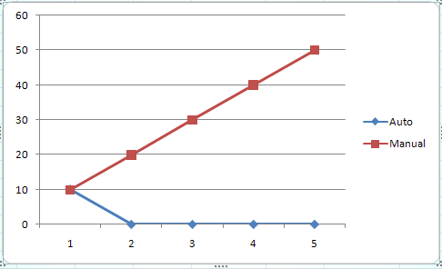
Automated Tests vs Manual Tests
Effort and Cost
  Lets assume 6 test cases
  Effort required to run all 6 manually => 10 min
  Effort required to write unit tests for all 6 cases => 10 min
  Effort required to run unit tests for all 6 cases => < 1 min
  Number of testing iterations => 5
  Total manual testing time => 50 min
  Total unit testing time => 10 min
Release | Manual Test | Auto Test | Manual Test Cumulative
1 | 10 | 10 | 10
2 | 10 | 0 | 20
3 | 10 | 0 | 30
4 | 10 | 0 | 40
5 | 10 | 0 | 50
Creative Commons Attribution Share-alike

Slide 5
Automated Tests vs Manual Tests
Effort and Cost
  Adding incremental Unit test cases is cheaper than adding incremental Manual Test Cases
    Eg registerDomain
      Case 1: Register a .com domain with all correct fields
      Case 2: Register a .com domain with an invalid nameserver
Creative Commons Attribution Share-alike

Slide 6
Automated Tests vs Manual Tests
Manual Testing is boring
  Noone wants to keep filling the same forms
  There is nothing new to learn when one tests manually
  People tend to neglect running manual tests
  Noone maintains a list of the tests required to be run if they are manual tests
Automated Tests on the other hand are code
  They are fun and challenging to write
  One has to carefully think of design for reusability and coverage
  They require analytical and reasoning skills
  They represent contribution that is usable in the future
Creative Commons Attribution Share-alike

Slide 7
Automated Tests vs Manual Tests
Manual Testing is not reusable
  The effort required is the same each time
  One cannot reuse a Manual Test
Automated Tests are completely reusable
  IMPORTANT: One needs to setup a Continuous Integration Server, a common Code Repository and a organization structure
  Once written the Automated Tests form a part of the codebase
  They can be reused without any additional effort for the lifetime of the Project
Creative Commons Attribution Share-alike

Slide 8
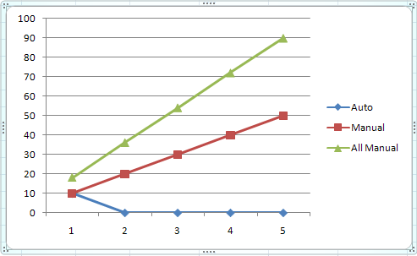
Automated Tests vs Manual Tests
Manual Tests provide limited Visibility and have to be Repeated by all Stakeholders
  Only the developer testing the code can see the results
  Tests have to be repeated by each stakeholder
    For eg Developer, Tech Lead, GM, Management
Automated Tests provide global visibility
  Developers, Tech Leads and Management can login and see Test Results
  No additional effort required by any of them to see the software works!!
Release | Manual Testing by Dev | Manual Testing by Team Leads | Manual Testing by Mgmt | Total Manual Testing | Auto Test | Dev Manual Test Cumulative | Total Manual Test Cumulative
1 | 10 | 5 | 3 | 18 | 10 | 10 | 18
2 | 10 | 5 | 3 | 18 | 0 | 20 | 36
3 | 10 | 5 | 3 | 18 | 0 | 30 | 54
4 | 10 | 5 | 3 | 18 | 0 | 40 | 72
5 | 10 | 5 | 3 | 18 | 0 | 50 | 90
Creative Commons Attribution Share-alike

Slide 9
Automated Tests vs Manual Tests
Manual Testing ends up being an Integration Test
  In a typical manual test it is very difficult to test a single unit
  In most circumstances you end up checking the unit alongwith backend services
  Introduces fragility – if something else breaks the manual test breaks
Automated Tests can have varying scopes
  One can test a unit (class / method), a module, a system etc
Creative Commons Attribution Share-alike

Slide 10
Automated Tests vs Manual Tests
Manual Testing requires complex Manual Setup and Tear Down
  Can involve frequently running db queries
  Can involve making changes to backend servers
  Steps become more complex with multiple dependent test cases
Automated Tests can have varying scopes and require less complex setup and teardown
  Unit Tests have external dependencies mocked – so no setup / teardown required
  Setup and Tear down are automated in Functional Tests using framework support
Creative Commons Attribution Share-alike

Slide 11
Automated Tests vs Manual Tests
Manual Testing has a high risk of missing out on something
  Each time a developer runs manual tests it is likely he will miss out on an important test case
  New developers may have no clue about the battery of tests to be run
Automated Tests have zero risk of missing out a pre-decided test
  Once a Test becomes a part of Continuous Integration – it will run without someone having to remember to run it
Creative Commons Attribution Share-alike

Slide 12
Automated Tests vs Manual Tests
Manual Tests do not drive design
  Manual tests are run post-facto and hence only drive bug-patching
Automated Tests and TDD / Test-First development drive design
  Writing a Unit test first clarifies the requirement and influences design
  Writing Unit Tests with Mock Objects etc forces clean design and segregation through abstraction / interfaces / polymorphism etc
Creative Commons Attribution Share-alike

Slide 13
Automated Tests vs Manual Tests
Manual Tests do not provide a safety-net
  Manual tests are run post-facto and hence only drive bug-patching
Automated Tests provide a safety-net for refactoring / additions
  Even New developers who have never touched the code can be confident about making changes
Creative Commons Attribution Share-alike

Slide 14
Automated Tests vs Manual Tests
Manual Tests have no training value
Automated Tests act as documentation
  Reading a set of Unit Tests clarifies the purpose of a codebase
  They provide a clear contract and define the requirement
  They provide visibility into different use cases and expected results
  A new developer can understand a piece of code much more by looking at Unit Tests than by looking at the code
  Unit Tests define the expected behavior of the code
Creative Commons Attribution Share-alike

Slide 15
Automated Tests vs Manual Tests
Manual Tests create crazy code clutter
  Most manual testing involves –
    System.outs to check values of variable names
    Useless log file entries in app server, db server etc
    Cause code / log / console clutter
      if then(s), flag based logging, event based log entries etc
    Slows down the application
Automated Tests reduce code clutter to zero
  Log file entries / System.outs are replaced by assertions in test code
  Even if specific console / log entries are needed they can reside in the test and not in the code
  Keep a live application / logs / console clutter-free and fast
Creative Commons Attribution Share-alike

Slide 16
Summary
Manual Tests take more Effort and Cost more than Automated Test to write and run
Manual Testing is boring
Automated Tests are reusable
Manual Tests provide limited Visibility and have to be Repeated by all Stakeholders
Automated Tests can have varying scopes and can test single units of code by Mocking the dependencies
Automated tests may require less complex setup and teardown
Creative Commons Attribution Share-alike

Slide 17
Summary
Automated Testing ensures you dont miss out on running a test
Automated Testing can actually enforce and drive clean design decisions
Automated Tests provide a Safety Net for refactoring
Automated Tests have Training value
Automated Tests do not create clutter in code/console/logs
Creative Commons Attribution Share-alike

Slide 18
Why do people not write Automated Tests
Initial learning curve
  Understanding Unit Testing Frameworks and Functional Testing Frameworks
  Understanding Continuous Integration and effective usage of it
  Understanding and learning Code Coverage Tools
  Figuring out how to organize the tests
  How to create Mock Objects?
  How to automate the running of the tests each time?
  Where to commit the tests?
Am I really going to be working on this same module again?
Will my tests be re-used? If not what is the point?
Creative Commons Attribution Share-alike

Slide 19
Why do people not write Automated Tests
Solution
  Spend time during First Release to freeze / design / implement -
    A Code Repository structure that incorporates Unit Tests and Functional Tests
    A CI Server integrated with the release
    Unit Testing Framework (any xUnit framework)
    Functional Testing Tools (Sahi / Watir / Selenium / QTP etc)
    Code Coverage Tools (Clover)
    Testing guidelines and principles
  Designate Responsibility
    Each developer MUST write Unit tests for multiple use cases per unit
    Designate a specific Developer to write Functional Tests
    The developer who writes the tests is also responsible for organizing them, committing them and linking them in CI
Creative Commons Attribution Share-alike

Slide 20
Why do people not write Automated Tests
Don’t give up
  If you come across a hurdle, pair
  Make sure you complete your testing responsibility
Check Code Coverage
  Use code coverage tools while coding and post-coding to check parts of your code that are covered by tests
Creative Commons Attribution Share-alike

Slide 21
What to Test
Unit Tests
  Ideally do not cross class boundaries
  Definitely do not cross process-boundaries
  Write a unit test with multiple cases
Functional Tests
  UI Tests using specific tools (Watir / Selenium / QTP / White etc)
  Tests one layer below the UI (Using APIs)
Creative Commons Attribution Share-alike

Slide 22
Best Practices
You must use a unit testing frameworks (there’s one for every platform)
You must have an auto-build process, a CI server, auto-testing upon commits etc
Unit Tests are locally during the day, and upon commit by CI Server
Over a period of time you may want to have your CI Server run tests selectively
Tests must be committed alongwith code
Creative Commons Attribution Share-alike

Slide 23
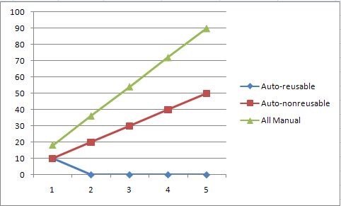
Best Practices
Organize the tests properly
If you do not commit Tests they are not reusable and the reduced effort advantage is lost
Creative Commons Attribution Share-alike

Slide 24
Visit our Websites http://careers.directi.com | http://www.directi.com

